Slide 1

Smart Logistics & Supply Chain Performance
End-to-end analytical pipeline — Python · MySQL · Power BI
PROJECT REPORT

Slide 2
Executive Summary
1,000 logistics records analyzed across 10 trucks — asset utilization, inventory levels, and delay patterns.
1,000
10
56.6%
Records Analyzed
Trucks Tracked
Delay Rate
434 on-time deliveries
79.6%
298
199
Avg Asset Utilization
Avg Inventory Units
Avg Demand Forecast

Slide 3

Data Pipeline Architecture
Load CSV
Clean Data
Queries
Power BI
Raw CSV → Python/Pandas → MySQL → Interactive Power BI Dashboard

Slide 4



Data Cleaning & Enrichment
Missing Values
Standardization
263 nulls in logistics_delay_reason — filled with mode value
Headers converted to lower_snake_case for clean SQL queries
Utilization Categories
Time Extraction
Month, week, day, hour, day_of_week derived from timestamp
Low (60–70%), Medium (71–85%), High (86–100%)

Slide 5
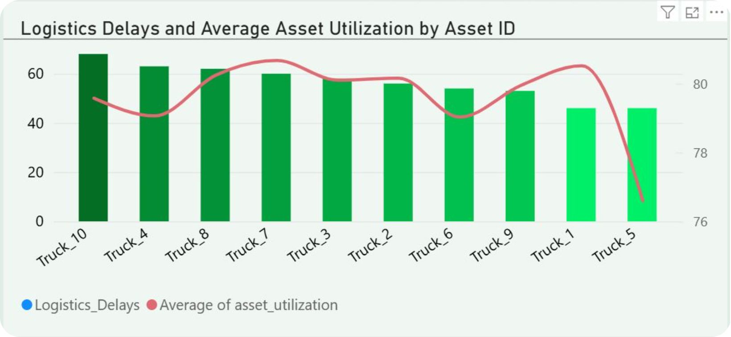
Fleet Asset Utilization Ranking
Top Performers
Truck 7 leads at 80.67% utilization with 29,602 units handled.
Delay Rates
Truck 10 has the highest delay rate at 64.76%; Truck 5 the lowest at 49.46%.

Slide 6
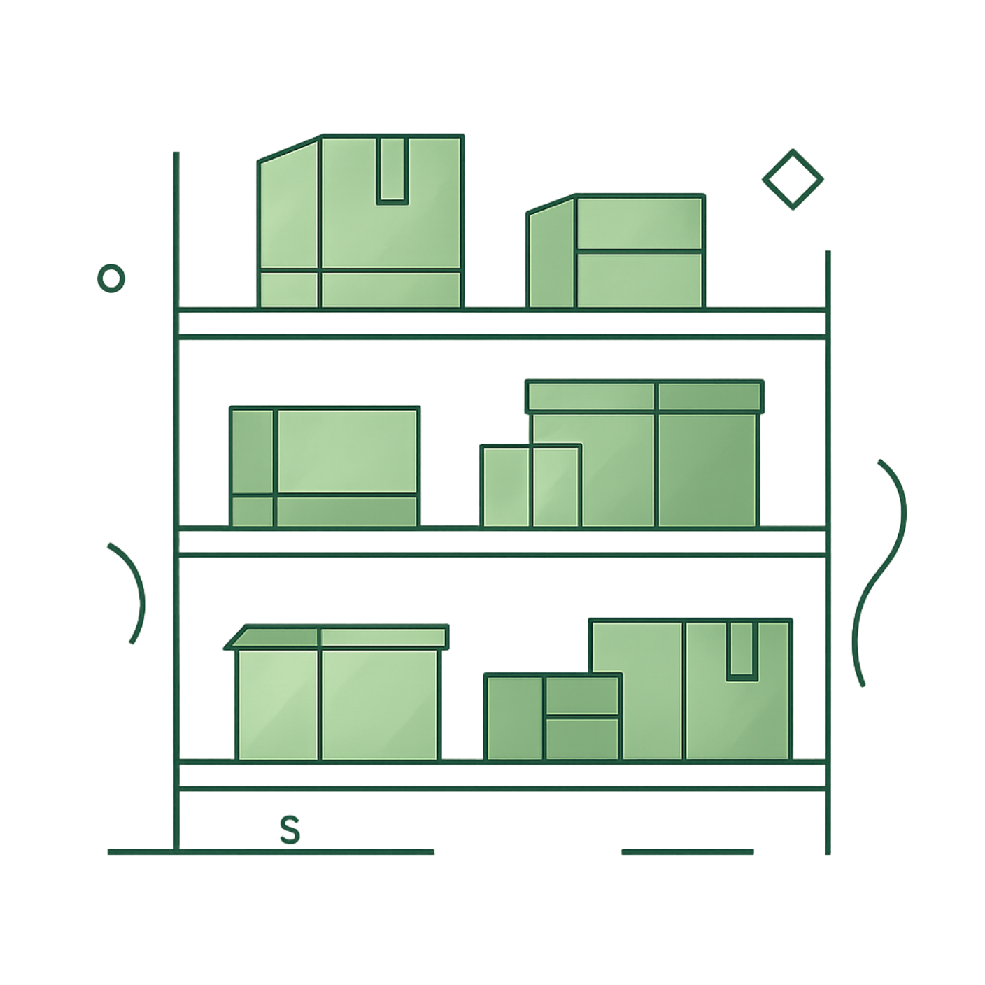

Inventory Level Distribution
Stockout Risk
Critical instances identified where inventory fell below demand forecast.
Medium inventory tier has the highest delay rate at 58.44%.

Slide 7

Temporal Bottlenecks
📅 Peak Month
📆 Peak Day
July — 54 total delays
Tuesday — 65% avg delay rate
⏰ Peak Hours
12 PM (33), 8 AM (32), 10 AM (31)

Slide 8
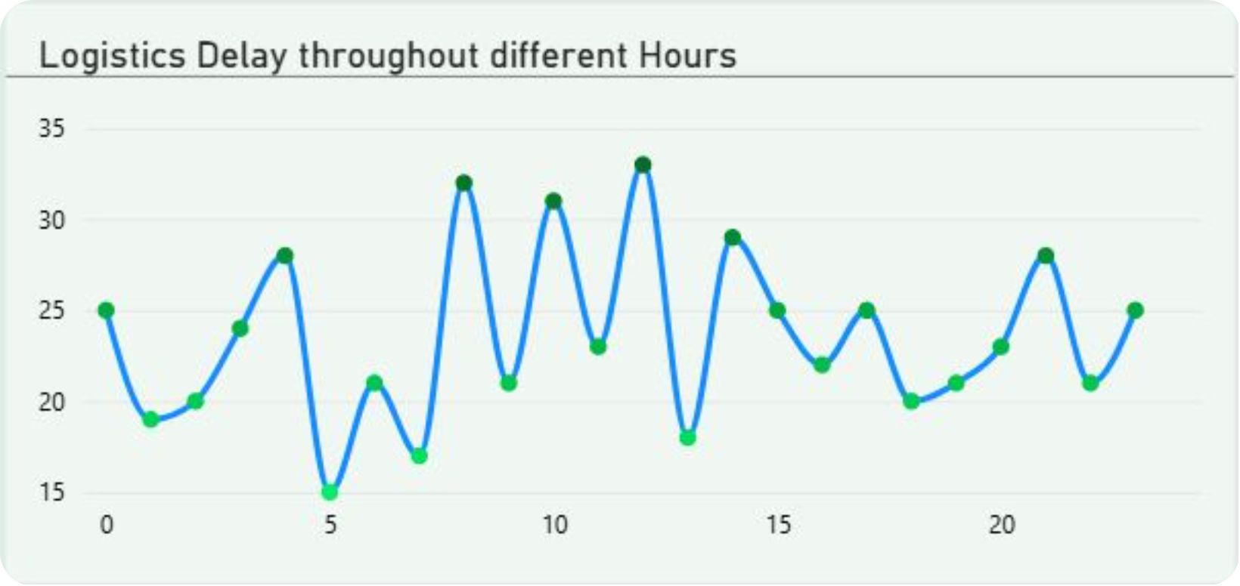
Delay Patterns at a Glance
Morning Rush
Delays cluster between 8 AM – 12 PM, with 12 PM peaking at 33 incidents.
Weekly Pattern
Tuesdays show the worst performance — avoid scheduling critical shipments on this day.

Slide 9


Recommendations: Fleet & Inventory
Service High-Stress Trucks
1
Truck 3, 7 & 8 — over 80% utilization, >56% delays. Re-route to lighter routes.
Dynamic Inventory Buffers
2
Auto-raise reorder points when forecasted demand exceeds inventory to prevent stockouts.

Slide 10

Recommendations: Scheduling
Block Rush Hours
Hold non-urgent shipments during 8 AM – 12 PM and all Tuesdays.
Shift Deliveries
Move to afternoons or later in the week to reduce delay exposure.

